Slide 2


Slide 3
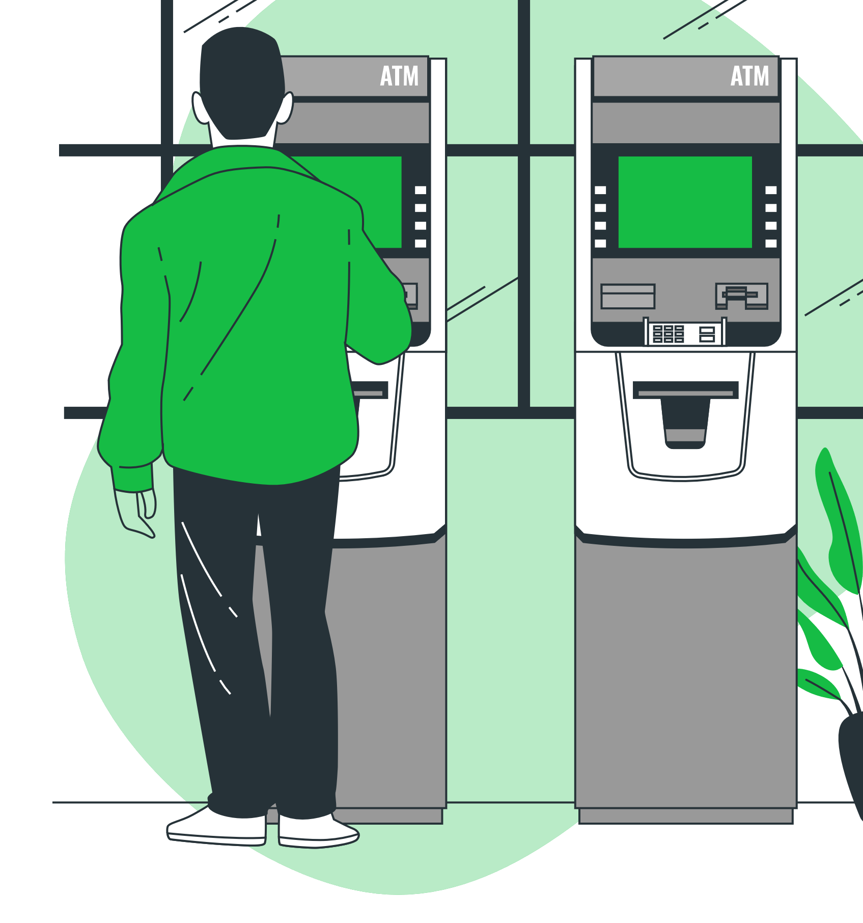
-
-
-
-
-

Slide 4
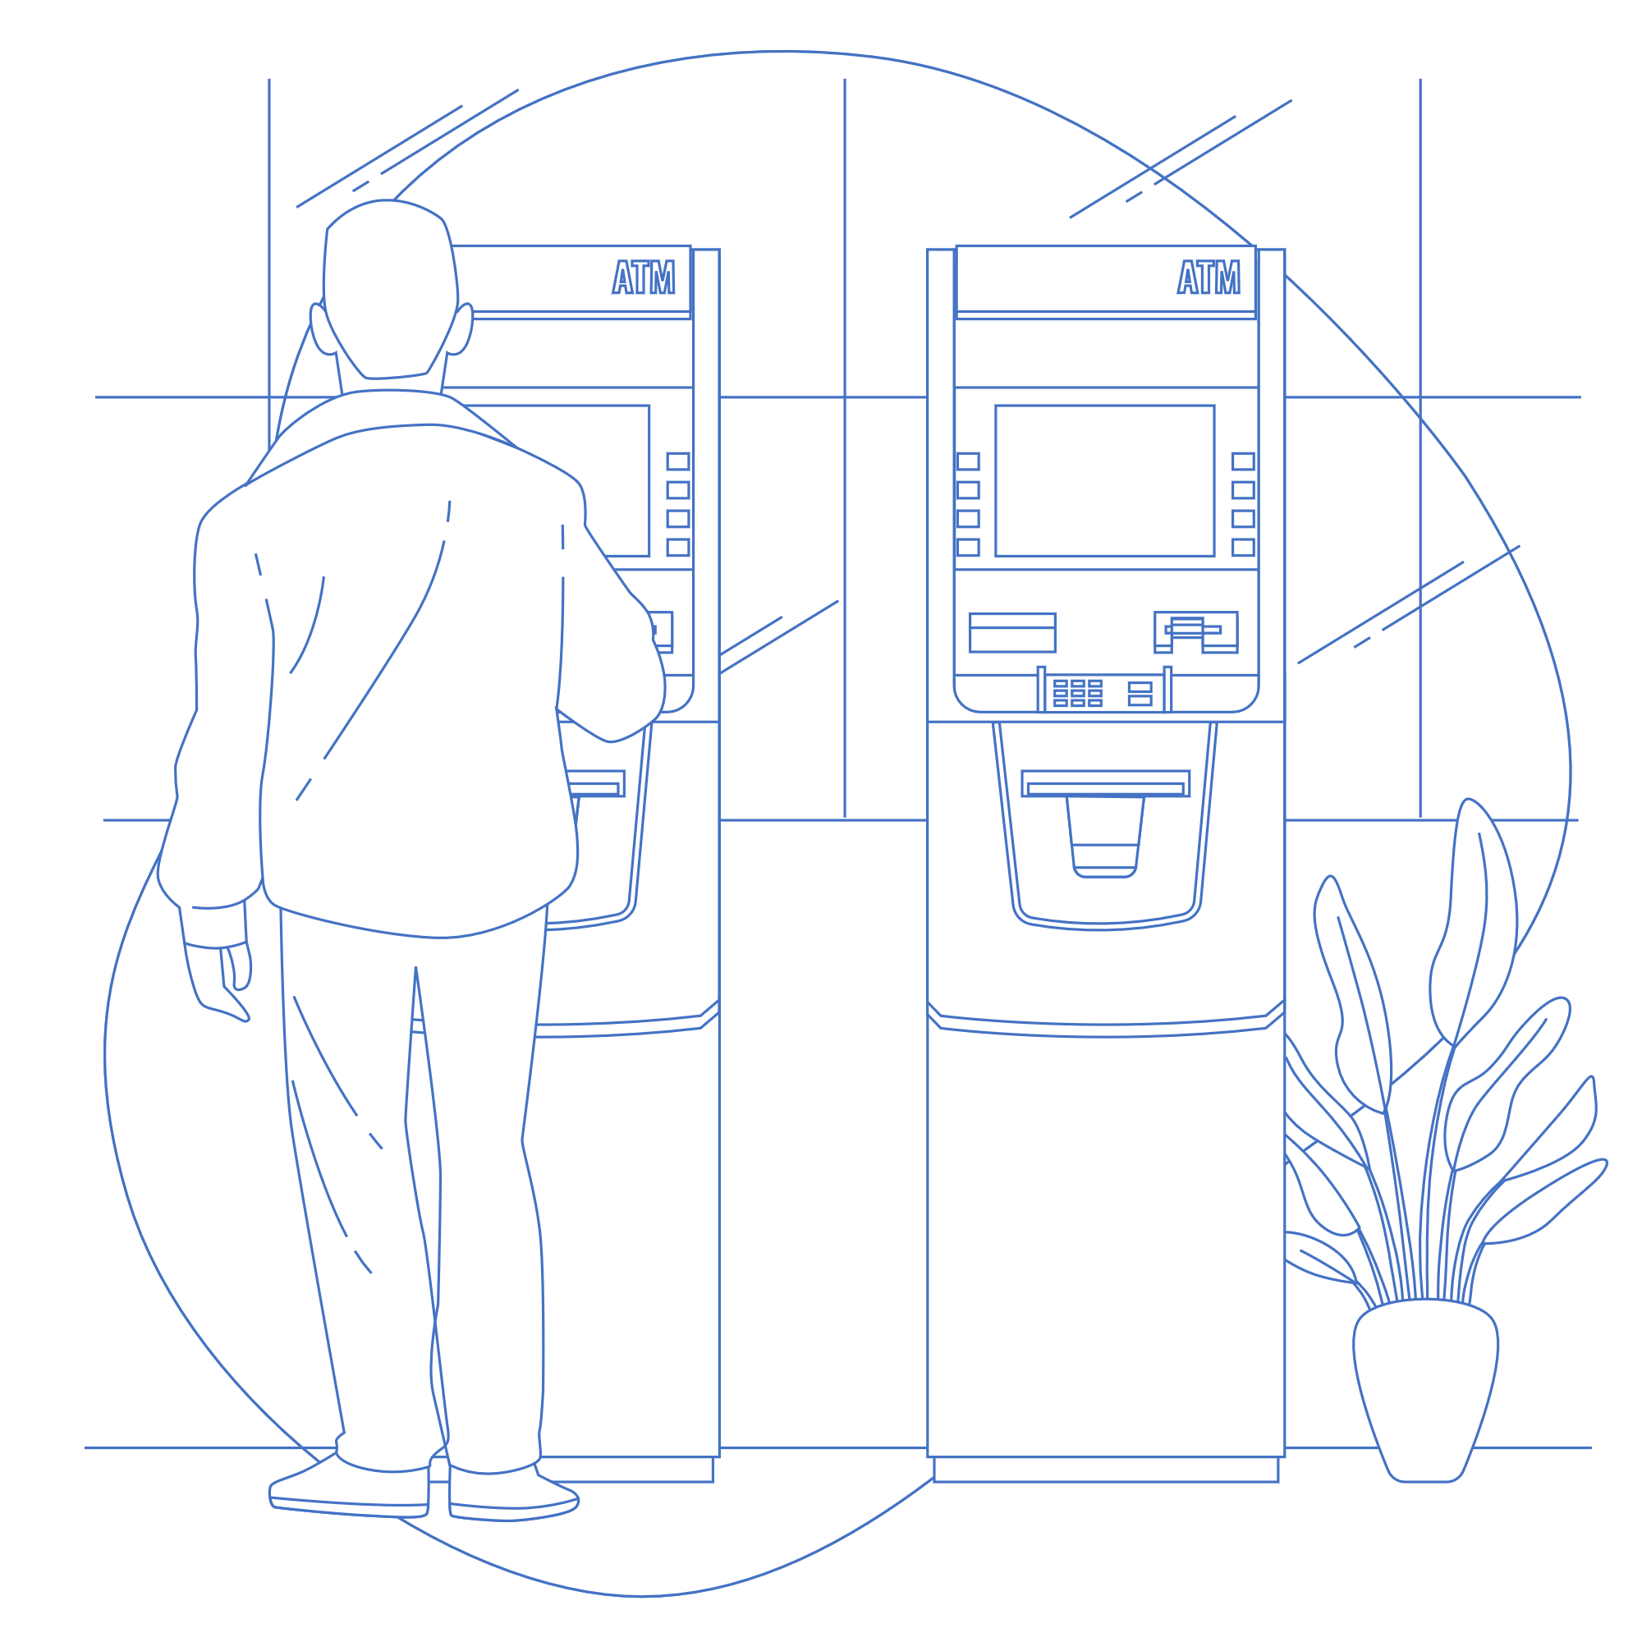

Slide 6


Slide 8
\

Slide 9
\

Slide 10

NIHAD
SENHADJI
BNP ED

Slide 11
NIHAD
SENHADJI
BNP ED

Slide 12


NIHAD
SENHADJI
BNP ED

Slide 13
BNP ED

Slide 14
NIHAD
SENHADJI

Slide 15
NIHAD
SENHADJI

Slide 16
NIHAD
SENHADJI

Slide 18


